Slide 1
Approach to thyroid nodules
Mohsen Eledrisi, MD, FACP, FACE
Department of Medicine
Hamad Medical Corporation
Doha, Qatar
www.eledrisi.com

Slide 2
CASE 1
A 38-year-old woman with neck swelling noted by her
husband about 2 months
She has no complaints
Past history: none
Exam showed a normal size thyroid with about 2 × 2 cm
mass in the lower part of the left lobe
How to approach?

Slide 3
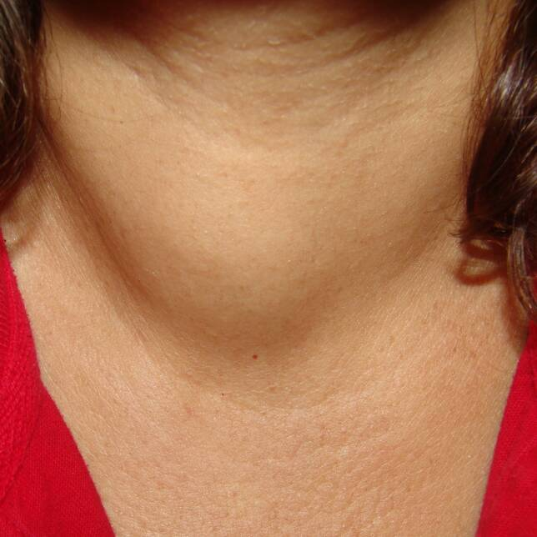

Slide 4
Thyroid nodule: history
Shortness of breath, dysphagia, dysphonia,
choking with position
Rate of growth
Symptoms of hyperthyroidism or hypothyroidism
History of head/neck irradiation
Family history of thyroid cancer

Slide 5
Evaluation of thyroid nodule
- History & examination
- Check TSH
Low TSH
Normal
TSH
High
TSH
or
Thyroid scan
Hyperthyroidism
Non-functional
Neck ultrasound
Manage
accordingly
Go to FNA
algorithm

Slide 6
Thyroid ultrasound
• Confirms the presence of nodules
• Detects non-palpable nodules
• Assess size & nature of nodules (risk of malignancy)
• For follow up of nodules
• To perform FNA-biopsy (U/S-guided)

Slide 7
Higher risk of malignancy
History of head and neck irradiation
Age <30 years
Family history of thyroid carcinoma
MEN type 2
Growing nodule
Hard nodule
Fixed nodule
Cervical lymphadenopathy
Compressive symptoms

Slide 8
High suspicious thyroid nodule features on ultrasound
Solid hypoechoic or solid hypoechoic component of
a partially cystic nodule with any of the following:
- Irregular margins
- Microcalcifications
- Rim calcifications
- Taller than wide shape
- Extrathyroidal extension
- Suspicious lymph node

Slide 9
Intermediate suspicious thyroid nodule features on ultrasound
Hypoechoic solid
with regular margin

Slide 10
Low suspicious thyroid nodule features on U/S
• Hyperechoic solid with regular margin
• Isoechoic solid with regular margin
Partially cystic nodule with solid areas

Slide 11
Very low suspicious
features on ultrasound
• Spongiform
• Partially cystic nodule
Cyst
Benign

Slide 12
Thyroid nodule:
when to do FNA?
• There are 2 systems:
1) ATA (American Thyroid Association)
2) ACR-TIRADS (American College of Radiology
Thyroid Imaging Reporting & Data Systems)

Slide 13
ATA system for FNA
• No scoring system
• Does not need a detailed ultrasound report
• Easy to use & memorize
• May lead to overuse of FNA
• May be less accurate than TIRADS

Slide 14
Thyroid nodule:
ATA FNA algorithm
Very low suspicion
(partially cystic, spongiform)
Low suspicion
(hyperechoic, isoechoic)
Intermediate &
high suspicion
(high suspicious, hypoechoic)
Cyst
(benign)
No FNA
Observation
Or
FNA if size ≥ 2 cm
FNA if
size ≥ 1.5 cm
FNA if
size ≥ 1 cm
American Thyroid Association. Thyroid 2016;26;1.

Slide 15
TIRADS system for FNA
• Depends on a scoring system
• Should be mentioned in the ultrasound report
• If not mentioned, it should be calculated
• Cannot be calculated if the report is not complete
• Selective, avoids unnecessary FNA
• May be better than ATA system
• Complex

Slide 16
Calculating TIRADS score
• If the ultrasound report did not mention TIRADS score
• The ultrasound report should include necessary items
www.tiradscalculator.com

Slide 17
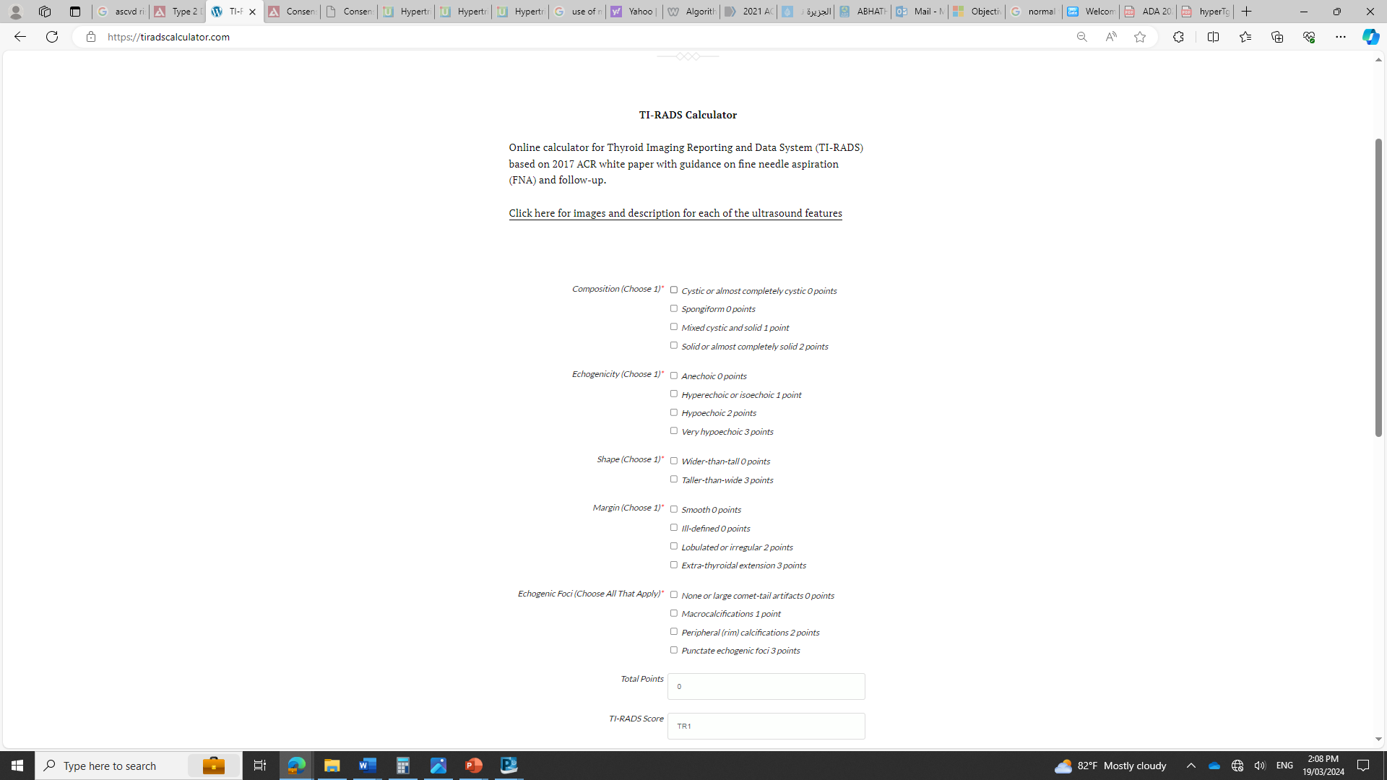

Slide 18
Thyroid nodule:
ACR-TIRADS FNA algorithm
TR1
TR2
TR3
TR4
TR5
No FNA
No follow up
FNA if ≥2.5 cm
Follow up if ≥1.5 cm
(at 1,3,5 years)
FNA if ≥1.5 cm
Follow up if ≥1 cm
(at 1,2,3,5 years)
FNA if ≥1 cm
Follow up if ≥0.5 cm
(every year for 5 years)
American College of Radiology. AJR 2017;208;1331.

Slide 19
Thyroid nodules: when to do surgery ?
• Malignancy
• Suspicious for malignancy
• Follicular neoplasm (FN) or suspicious for FN
• Indeterminate cytology + high risk (consider)
• Repeat non-diagnostic + high risk (consider)

Slide 21
CASE 2
A 66-year-old lady had a recent acute minor
ischemic stroke
Doppler ultrasound of the carotid arteries:
Showed 2 thyroid nodules
She has no complaints
Physical exam including the thyroid was normal.
How would you approach?

Slide 22
Incidentally-discovered thyroid nodule
(Thyroid incidentaloma)
Non-palpable thyroid nodules that are detected during
other imaging procedures
Same approach as thyroid nodule
History and physical examination
Check TSH
Thyroid ultrasound
American Thyroid Association/AACE. Thyroid 2012;22:1200

Slide 23
Evaluation of thyroid nodule
- History & examination
- Check TSH
Low TSH
Normal
TSH
High
TSH
or
Thyroid scan
Hyperthyroidism
Non-functional
Neck ultrasound
Manage
accordingly
Go to FNA
algorithm

Slide 24
Case 3
A 48-year-old lady presents with neck swelling and
shortness of breath
Neck swelling for 5 years
SOB on exertion increasing over the last year
No medications
Exam: pulse 90/min. diffusely enlarged Thyroid
TSH 1.2 (0.4-4.5)
How to approach?

Slide 25
Evaluation of goiter
Same history as thyroid nodules
Rate of growth
Compressive symptoms:
Dyspnea
Cough, wheezing
Change in voice
Choking sensation
Dysphagia
Ask about “B” symptoms (fever, weight loss, sweating)
Examination:
Size, nodules, lymph nodes, tracheal deviation

Slide 26
Evaluation of goiter
TSH
Ultrasound neck:
Features, size and extension of thyroid
Nodules (nature, size)
If hyperthyroidism, obtain thyroid scan
If compressive symptoms:
CT scan neck (non-contrast) or MRI
FNA algorithm for thyroid nodules
Consider pulmonary function test for respiratory symptoms
Barium swallow for dysphagia

Slide 27
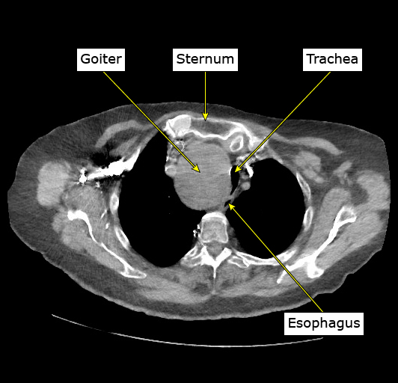
CT scan showing goiter causing tracheal
displacement and narrowing

Slide 28
Indications for surgery for goiter
Compressive symptoms (confirmed to be caused
by the goiter)
Cosmetic reason
Result of FNA requiring surgery

